Slide 1
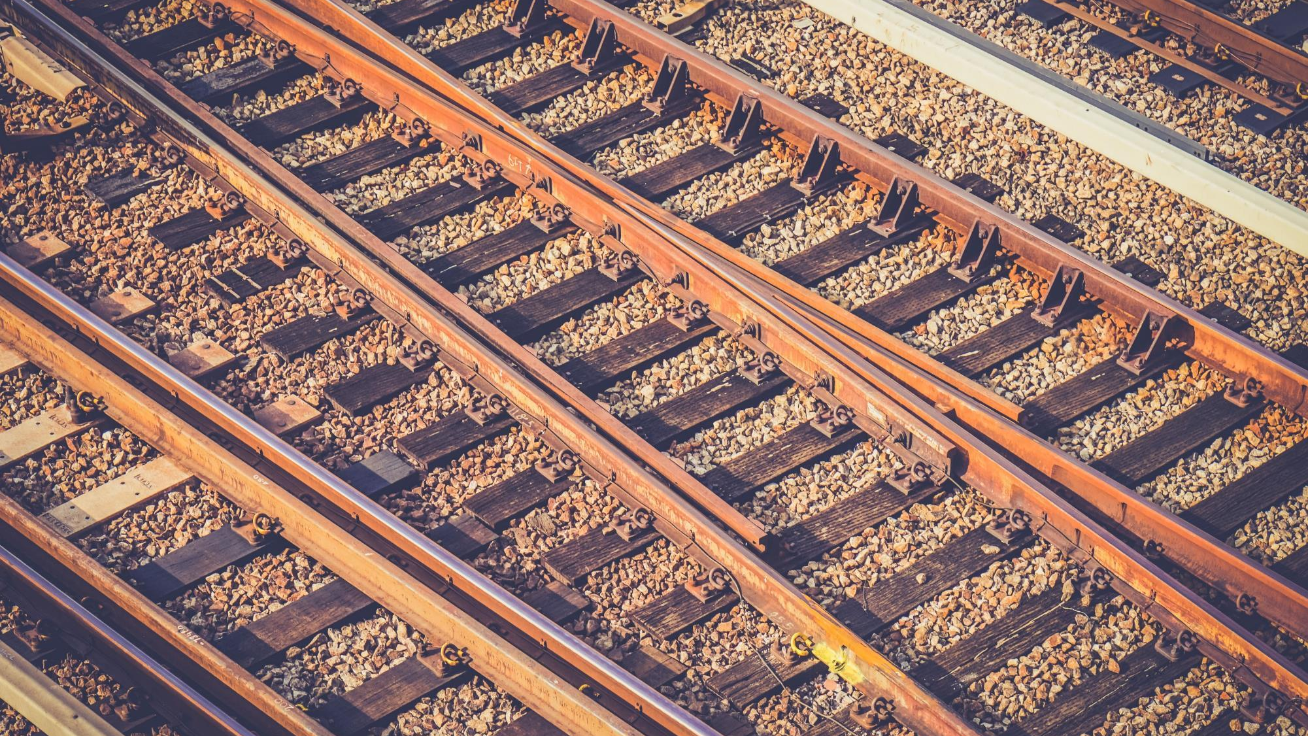
SMART RAIL
Smart India Hackathon - 2018
Black Caps
Notes:
To use this title animation slide with a new image simply 1) move the top semi-transparent shape to the side, 2) delete placeholder image, 3) click on the picture icon to add a new picture, 4) Move semi-transparent shape back to original position, 5) Update text on slide.

Slide 2
Inaudible Announcements
Unclean and Unhygienic
Theft and Misplacement of Luggage
Non-uniform and Price discrimination by vendors
Overcrowding at Enquiry and Ticket counters
PROBLEMS

Slide 3
Don’t worry, we have it covered

Slide 4
Enquiry
The Idea of Digital Enquiry Window
NO MORE WAITING IN LONG QUEUES!

Slide 5
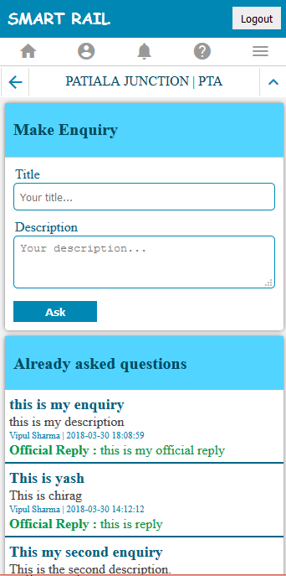
Enquiry
User creates enquiry online

Slide 6
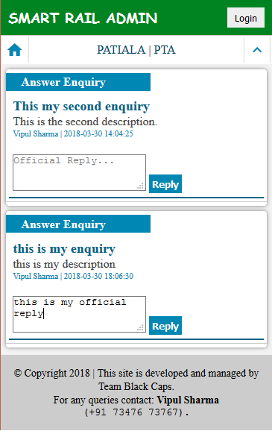
Enquiry
Admin receives enquiry
Admin responds to query

Slide 7
Enquiry
User receives official reply ☺

Slide 8
Announcements
Time saving digital announcements panel
I can’t hear the announcements..
Wohoo I got them on my phone!

Slide 9
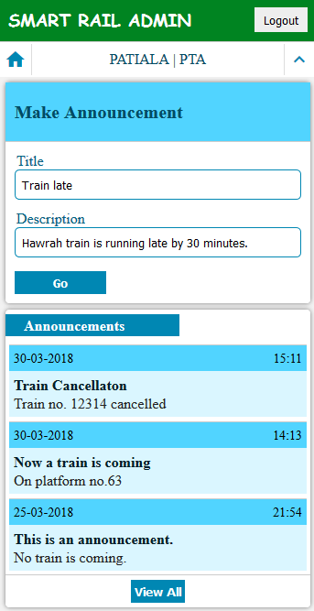
Announcements
Admin uploads announcements

Slide 10
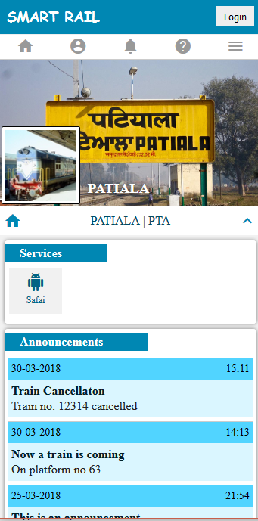
Announcements
User receives announcements on app ☺

Slide 11
Safai
Public engaging station cleaning feature
BE A PART OF
SWACHH BHARAT ABHIYAAN!

Slide 12
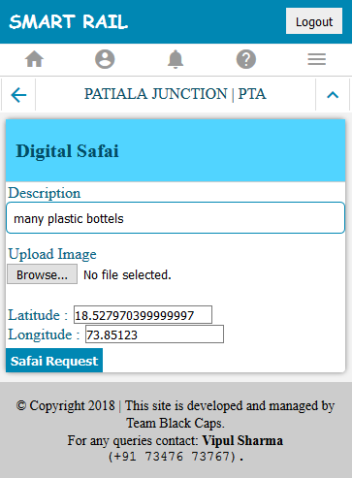
Safai
User reports dirty area with optional photograph

Slide 13
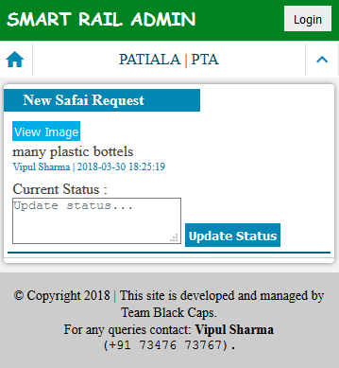
Safai
Admin receives request with GPS coordinates

Slide 14
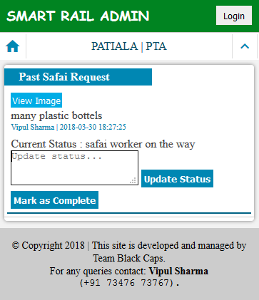
Safai
Admin assigns cleaner for the task
Cleaner marks it done ☺

Slide 15
Bholu
Easy access of Services using CHATBOT
YOUR
VIRTUAL ASSISTANT!

Slide 16
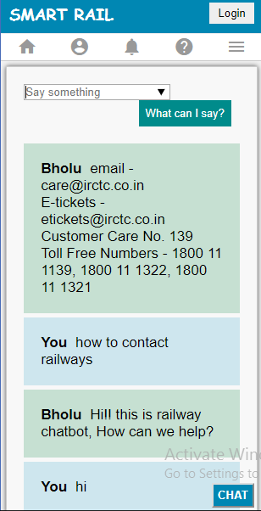
Bholu
Enquire the bot

Slide 17
Maps
Path to anywhere on Railway Station
Oh! man where is the exit?
Wait, I have Smart Rail Map ☺

Slide 18
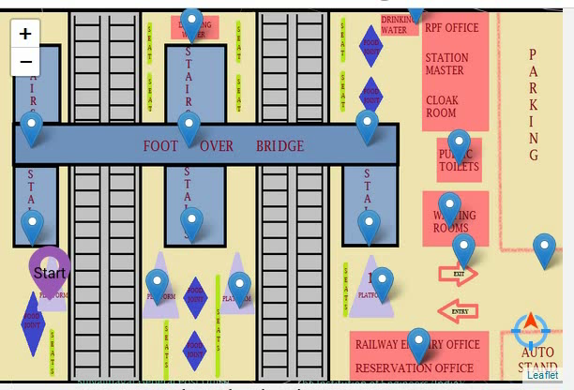
Maps
Click on destination and get your path

Slide 19
Future Aspects
High quality Mapping using Augmented Reality
Robotic assistance at station

Slide 20
THANK YOU!

